Slide 1










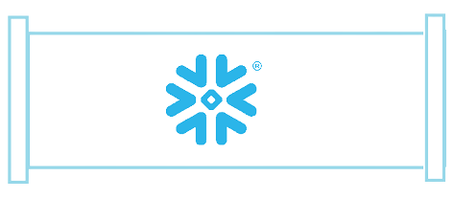

















DATA SOURCES
DATA EXTRACTION
Security
RBAC Accelerator
Monitoring LoginHistory
College Faculty/Admins
Ingest Interface
RDS
Mulesoft
LANDING
EDW
DATAMART
Raw data
In Transient Tables
Transformed historical data in Tables loaded using Matillion
Latest Data stored in Dimension and Fact Tables/Views created using Snowflake Stored Procedure called from Matillion
ODBC Connector
RLS Accelerator
Amazon Rekognition
twitter
Shares
Snowpipe
Structured Data
Reader Account
Semi-structured Data
Amazon S3
Lambda
Snowflake Python Connector
Data Masking
Monitoring Accelerator
Job Logging / Notification
Audit
& Governance
Government Agencies like NAAC/NSSO
Object Tagging
Data Quality Check
Data Cataloging/ Lineage -Snowboard
Project Management
Team Recognition
Data Modelling
CI/CD and Version Control

